Slide 1
A Festive PhD Lecture
Open Problems
Gil Cohen

Slide 2
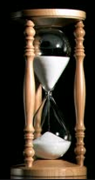
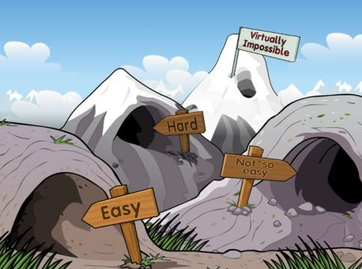
Two-source extractors
Bi-Lipschitz bijections between halfspaces
Bit fixing
extractors
Threshold
circuits

Slide 3
Two-source extractors
Bit fixing
extractors
Threshold
circuits
Bi-Lipschitz bijections between halfspaces

Slide 4
Threshold circuits

Slide 5
Threshold circuits (and a bonus conjecture)
Can one “cheaply” compute majority on n bits using only majority on 3 bits as an atomic operation?
Theorem [Val84*, Bro92, GM96, Zwi96, Gol11]. Majority can be computed by a log-depth formula consisting of 3-bits-majority gates.

Slide 6
Threshold circuits (and a bonus conjecture)
Can one “cheaply” compute majority on n bits using only majority on 3 bits as an atomic operation?
Theorem [Val’84*, Bro’92, GM’96, Zwi’96, Gol’11]. Majority can be computed by a log-depth formula consisting of 3-bits-majority gates.

Slide 7
Threshold circuits (and a bonus conjecture)
Can one “cheaply” compute majority on n bits using only majority on 3 bits as an atomic operation?
Theorem [Val’84*, Bro’92, GM’96, Zwi’96, Gol’11]. Majority can be computed by a log-depth formula consisting of 3-bits-majority gates.
Drawback - the proof is existential.
Theorem [CDIKMRR’13]. There is a uniform log-depth formula composed only of 3-bits-majority gates, that computes majority on n bits assuming a promise on the bias (bias $>2^{−Ω(\sqrt{\log{n}})}$).
The assumption on the bias can be dropped assuming standard hardness assumptions.
Open Problem. Give an explicit majority-from-majorities formula.

Slide 8
Threshold circuits (and a bonus conjecture)
What if we are given j-out-of-k threshold gates?
For applications, we want a formula on n inputs, with such gates, that computes the $\left(\frac{j−1}{k−1}\right)n$-out-of-$n$ threshold function.
Valiant’s technique breaks.
Theorem [CDIKMRR’13]. There is such a formula with linear-depth.
Theorem [CDIKMRR’13]. There is such a formula with log-depth, though it assumes some promise on the bias.
Open Problem. Can a log-depth formula accomplish the task? (regardless of uniformity).

Slide 9
Bit-Fixing Extractors

Slide 10
Bit-Fixing Extractors
0
0
1
0
0
1
1
1
0
0
1
1
0
0
0
0
1
0
1
0
1
1
Assumption. k of the n bits are jointly uniform, and the rest are fixed.
Goal. Output $Ω\left(k\right)$ bits that are close to uniform.
[GRS’06, Rao’09]
[Vaz’85,BBR’85,CGHFRR’85]
[KZ’06]
$$1$$
$$poly\log{n}$$
$$\sqrt{n}$$
$$\frac{n}{2}$$
$$n$$
Theorem [KZ’06]. For any k, one can output $0.5\log{(k)}−O(1)$ bits.
Theorem [RV’10]. Space bounded streaming algorithms cannot output more than $O\left(\log{k}\right)$ bits for $k=o\left(\log{n}\right)$.

Slide 11
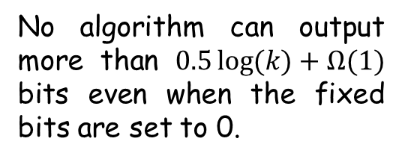
Bit-Fixing Extractors
?
[GRS’06, Rao’09]
[Vaz’85,BBR’85,CGHFRR’85]
[CS’14]
[CS’14]
[KZ’06]
$$1$$
$${\left(\log^{∗}{n}\right)}^{2/3}$$
$$poly log{\log{n}}$$
$$poly\log{n}$$
$$\sqrt{n}$$
$$\frac{n}{2}$$
$$n$$
No algorithm can output more than $0.5\log{(k)}+Ω(1)$ bits even when the fixed bits are set to 0.
Can output $k−O(1)$ bits.
Running-time $n^{{\left(\log{\log{n}}\right)}^{2}}$.
Open Problem. Design an efficient bit-fixing extractor that outputs $Ω(k)$ bits for $k=poly\log{\log{n}}$.
Open Problem. Is there a threshold behavior? If so, is it at $k=\log{\log{n}}$ ?

Slide 12
Bi-Lipschitz Bijection between halfspaces

Slide 13
Cube vs. Ball
$$f :$$
$${\left\{0,1\right\}}^{n}$$
$$→$$
$$B_{n}=\left\{x∈{\left\{0,1\right\}}^{n+1} :\left|x\right|>n/2\right\}$$
Majority
$$\left\{x∈{\left\{0,1\right\}}^{n+1} :x_{n+1}=1\right\}$$
Dictator
n
Strings with Hamming weight k
k
0

Slide 14
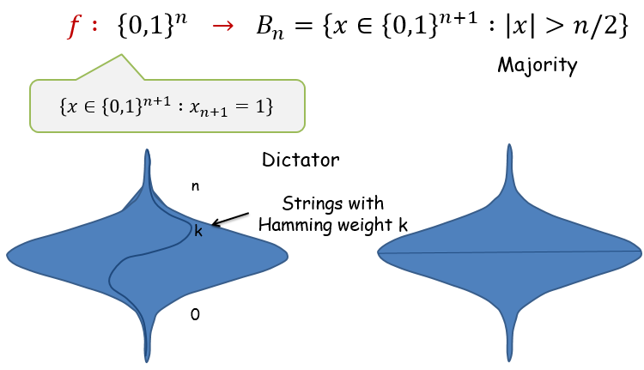
Respecting distances
Open Problem [LV’11]. Prove that for any bijection $f:{\left\{0,1\right\}}^{n}→B_{n}$,
$avgStretch\left(f\right)=E_{x\sim y}\left[dist\left(f\left(x\right),f\left(y\right)\right)\right]>{\left(\log{n}\right)}^{ω\left(1\right)}$.
A “Naïve” Upper Bound.
$$f\left(x\right)=\left\{\begin{matrix}x∘0 \left|x\right|>n/2 \\ flip\left(x\right)∘1 \left|x\right|≤n/2\end{matrix}\right.$$
Average stretch $Θ\left(\sqrt{n}\right)$

Slide 15
Respecting distances
Theorem [BCS’13]. $∃ ψ : {\left\{0,1\right\}}^{n}→B_{n}$ such that
$$∀x\sim y$$
of
${ \left\{0,1\right\}}^{n} dist\left(ψ\left(x\right),ψ\left(y\right)\right)≤4$
$∀x\sim y$
of
$$B_{n}$$
$dist\left(ψ^{−1}\left(x\right),ψ^{−1}\left(y\right)\right)≤5$
$$ψ : \left\{x : x_{n+1}>0\right\}→\left\{x : {x_{1}+⋯+x}_{n+1}>0\right\}$$
Switching to $±1$ notation
Open Problem. Does the result hold for general balanced halfspaces
$ψ_{a} : \left\{x : x_{n+1}>0\right\}→\left\{x : {a_{1}x_{1}+⋯+a_{n+1}x}_{n+1}>0\right\}$ ?
Open Problem. Exhibit a density half subset $A⊂{\left\{0,1\right\}}^{n+1}$ such that any bijection $f : {\left\{0,1\right\}}^{n}→A$ has super constant average stretch. Even average stretch 2.001 ! (for 2 take A = even weight strings).

Slide 16
Two-Source Extractors

Slide 17
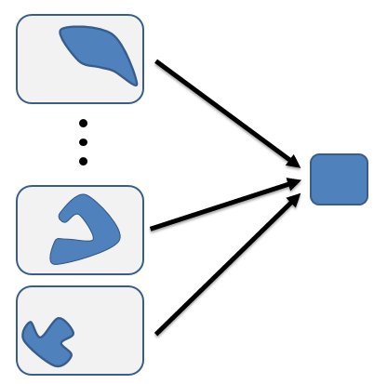
multi-source extractors
Definition [CG88]. A random variable X, that is uniformly distributed over some set $T⊆{\left\{0,1\right\}}^{n}$ with size $\left|T\right|=2^{k}$ is called an $(n,k)$-source.
$${\left\{0,1\right\}}^{n}$$
$$T$$
* Existential argument requires 2 n-bit sources with entropy $log n$.
* Explicit 2-source extractors:
$0.49n, 0.49n$ [Bourgain05].
$0.51n, \log{n}$ [Raz05].
* Explicit 3-source extractors:
$δn, \log{n}, \log{n}$ [Raz05].
$\log^{12}n, \log^{12}{n}, \log^{12}{n}$ [Li15].

Slide 18
multi-source extractors
Theorem [C’15]. $∀δ$ there is an explicit 3-source extractor for entropies
$$k_{1}=δn$$
$$k_{2}=poly\left(1/δ\right)⋅log⁡n$$
$$k_{3}=poly\left(1/δ\right)⋅log⁡\log{n}$$
Open Problem. Can one use the fact that the entropy of the third source is tantalizingly low so to remove the need for the third source altogether?

Slide 19
Conclusions
!

