Slide 1
Extractors for Near Logarithmic Min-Entropy
Gil Cohen Leonard J. Schulman

Slide 2
Multi-Source Extractors
Randomness extractors
A randomness extractor is a function that transforms a “weak source of randomness” to a uniformly random string.
Min-entropy [Chor-Goldreich’84]
A random variable $X$ has min-entropy $k$ if $∀x \operatorname{Pr}\left[X=x\right]≤2^{−k}$.
$X$ is then called a $k$–source.
Multi-source extractors [Chor-Goldreich’84]
A function $Ext:{\left({\left\{0,1\right\}}^{n}\right)}^{t}→{\left\{0,1\right\}}^{m}$ is a $t$-source extractor for min-entropy $k$ if for any independent $k$-sources $X_{1},…,X_{t}$, $Ext\left(X_{1},…,X_{t}\right)\sim U_{m}$.
Fact
For any $t≥2$ there exists a $t$-source extractor for min-entropy $k\sim \frac{1}{t−1}⋅\log{n}$.

Slide 3
Explicit multi-source extractors – historic timeline
1984
Chor-Goldreich
2: $0.51n$
2004-06
2011-15
Barak-Impagliazzo-Wigderson, Barak-Kindler-Shaltiel-Sudakov-Wigderson, Bourgain, Raz, Rao, Barak-Rao-Shaltiel-Wigderson
Li x 3, C, Chattopadhyay-Zuckerman, Li, Meka
2: ${\left(\log{n}\right)}^{O(1)}$
2: $0.49n$ ; $0.51n$, $\log{n}$
2: $O\left(\log{n}\right)$
3: $δn$, $\log{n}$, $\log{\log{n}}$
3: $δn$, $\log{n}$, $\log{n}$
$1/δ$: ${\left(\log{n}\right)}^{2+δ}$
$1/δ$: $n^{O(δ)}$

Slide 4
Main result
Observing a barrier
3rd generation techniques seem insufficient to yield extractors for $o\left(\log{n}\right)$ sources with min-entropy ${\left(\log{n}\right)}^{1.99}$.
* The lightest-bin condenser [Li’12] that is based on [Feige’99].
* Resorting to [Braverman’09] as in [Chattopadhyay-Zuckerman’15].
* Finding “triple tree-structure” sources within arbitrary sources [C’15].
Main result
Explicit extractor for $O\left(1/δ\right)$ sources with min-entropy ${\left(\log{n}\right)}^{1+δ}$.
New pseudo-random object – Independence-preserving merger (IPM).
IPM were further studied and used in subsequent works [Chattopadhyay-Li’16], [C’16a], [Li’16], [C’16b].

Slide 5
Explicit multi-source extractors – future timeline
Chor-Goldreich
Barak-Impagliazzo-Wigderson, Barak-Kindler-Shaltiel-Sudakov-Wigderson, Bourgain, Raz, Rao, Barak-Rao-Shaltiel-Wigderson
2: $0.51n$
1984
2004-06
2: $0.49n$ ; $0.51n$, $\log{n}$
2011-15
3: $δn$, $\log{n}$, $\log{n}$
$1/δ$: $n^{O(δ)}$
Li x 3, C, Chattopadhyay-Zuckerman, Li, Meka
C, Chattopadhyay-Li, C, BenAroya-Doron-TaShma, C, Li
This work
2: ${\left(\log{n}\right)}^{O(1)}$
$1/δ$: ${\left(\log{n}\right)}^{1+O(δ)}$
3: $δn$, $\log{n}$, $\log{\log{n}}$
2: $\tilde{O}\left(\log{n}\right)$
2: $O\left(\log{n}\right)$
$1/δ$: ${\left(\log{n}\right)}^{2+O(δ)}$
10: $O\left(\log{n}\right)$

Slide 6
Independence-Preserving Mergers

Slide 7
Independence-preserving mergers
Mergers [TaShma’96], [Lu-Reingold-Vadhan-Wigderson’03], [Raz’05], [Dvir-Raz’05], [Dvir-Shpilka’05], [Rao’05], [Zuckerman’07], [Dvir-Wigderson’08], [Dvir-Kopparty-Saraf-Sudan’09], [Barak-Kindler-Shaltiel-Sudakov-Wigderson’05], [C’15].
$$Y_{1}$$
☺
☺
$$X$$
$$Mrg\left(Y_{1},…,Y_{r},X\right)\sim U$$
$$Y_{r}$$

Slide 8
Independence-preserving mergers
$$Y_{1}$$
☺
☺
☺
$$X$$
$$Y_{r}$$
☺
$$Y_{1}^{′}$$
$$X′$$
$$Y_{r}^{′}$$
More formally
$$∃g∈\left[r\right] \left(Y_{g},Y_{g}^{′}\right) \sim U×Y_{g}^{′} \underset{⇒}{}$$
$$\left(IPM\left(Y_{1},…, Y_{r},X\right),IPM\left(Y_{1}^{′},…, Y_{r}^{′},X^{′}\right)\right) \sim U×IPM\left(Y_{1}^{′},…, Y_{r}^{′},X^{′}\right)$$

Slide 9
A Flavor of a Two Variable IPM

Slide 10
A two variable IPM
Setup
$X\sim U$, $Y\sim U$, and $X^{′},Y^{′}$ for which one of the following holds:
* $\left(X,X′\right) \sim U×X′$
* $\left(Y,Y′\right) \sim U×Y′$
Goal
Design an efficiently-computable function $IPM$ such that
$$\left(IPM\left(X,Y,W\right),IPM\left(X^{′},Y^{′},W\right)\right) \sim U×IPM\left(X^{′},Y^{′},W\right)$$

Slide 11
Seeded extractors
Seeded extractors [Nisan-Zuckerman’93]
A function $Ext:{\left\{0,1\right\}}^{n}×{\left\{0,1\right\}}^{d}→{\left\{0,1\right\}}^{m}$ is called a $k$-seeded extractor if for any $k$-source $X$ and an independent $Y\sim U_{d}$,
$$\left(Ext\left(X,Y\right),Y\right) \sim U_{m}×Y$$
$$d\sim \log{n}$$
Goal
$$m\sim k$$
Given $n,k$, construct extractors with small $d$ and large $m$.
Matched (almost) by explicit constructions [Nisan-Zuckerman’93], [Srinivasan-Zuckerman’94], [TaShma’96], [Zuckerman’96], [Trevisan’99], [Raz-Reingold-Vadhan’99], [Impagliazzo-Shaltiel-Wigderson’00], [Reingold-Shaltiel-Wigderson’00], [Shaltiel-Umans’01], [Lu-Reingold-Vadhan-Wigderson’03], [Guruswami-Umans-Vadhan’06], [Dvir-Wigderson’08], [Dvir-Kopparty-Saraf-Sudan’09], [TaShma-Umans’11].

Slide 12
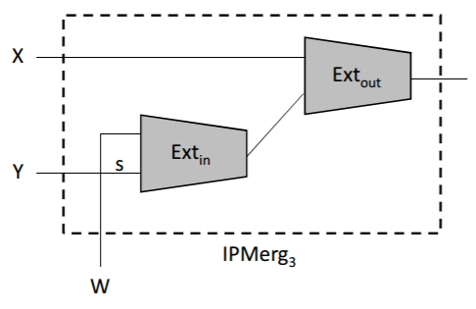
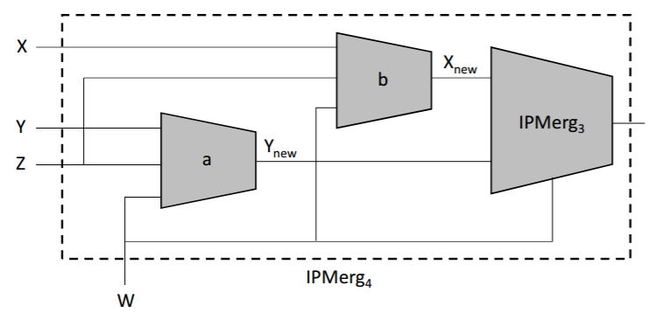
A two variable IPM
A little lemma
Let $Ext$ be a $k$-seeded extractor. Then, for any $\left(k+m\right)$-source $Z$ and any $Z′$, if $\left(S,S′\right)\sim U×S′$ then
$$\left(Ext\left(Z,S\right),Ext\left(Z′,S′\right)\right) \sim U_{m}×Ext\left(Z′,S′\right)$$
First attempt
Forget about $W$ and define $IPM\left(X,Y,W\right)=Ext\left(X,Y\right)$.
Hierarchy of independence
Third attempt
Second attempt
The functions $a$,$b$ are computed using alternating extraction [Dziembowski-Pietrzak’07]. The analysis is more delicate than what was required in previous works [Dodis-Wichs’09], [Li’13], [Li’15], [C’15] (and in subsequent works.)
Don’t waste all of $Y$: $IPM\left(X,Y,W\right)=Ext\left(X,Ext\left(W,Y_{s} \right)\right)$
Use $W$as a “buffer”: $IPM\left(X,Y,W\right)=Ext\left(X,Ext\left(W,Y\right)\right)$

Slide 13
Summary
A new result
* First explicit $O\left(1\right)$-source extractor for min-entropy approaching $\log{n}$.
* An$O\left(1/δ\right)$-source extractor for min-entropy ${\left(\log{n}\right)}^{1+δ}$.
A new idea
* Introduced and constructed independence-preserving mergers.
* IPM turned out to be useful!

Slide 14
Open problems
1984
2004-06
2011-15
2: $O\left(\log{n}\right)$
2: $\log{n}+O\left(1\right)$

Slide 15
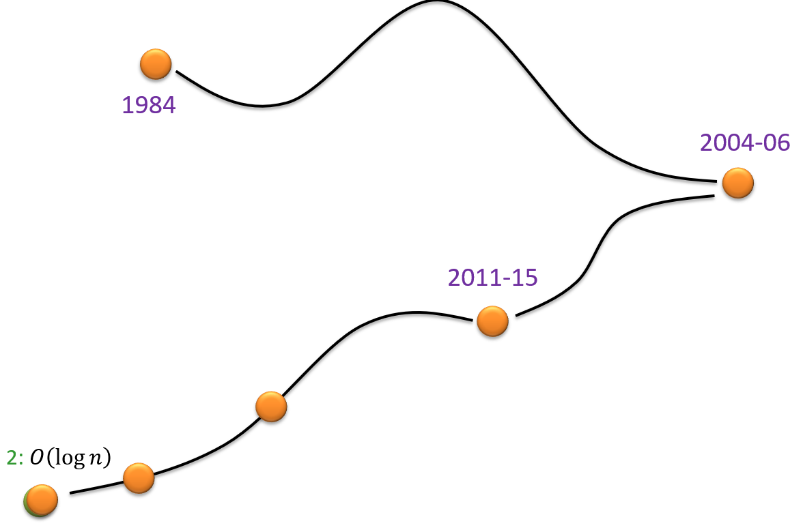
Open problems
2: $\log{n}+O\left(1\right)$

Slide 16
Open problems
1984
2004-06
2011-15
2: $O\left(\log{n}\right)$
Thanks!
2: $\log{n}+O\left(1\right)$

